Slide 1
ting Workshops
Session One

Slide 2
What are you going to do on this course?
Describe
Describe a scene showing the effects of climate change
Think Up
Think up an inspiring character who can show your readers what we can do about climate change and write a short story about it.
Leave
Leave your readers with a suitable moral

Slide 3
How you can present your story…
As a narrative of no more than 1000 words
As a poem/song/rap
As a diary
As a postcard

Slide 4
Exhibit / Showcase your story
Display in School / Library
Shared on social media
At a storytelling session
Recorded/Videoed and put onto YouTube

Slide 5
It’s Quiz Time
Write down your answers on your worksheet
There’s no prize for winning, the quiz is just to help you understand what climate change is, how it affects us and some solutions to it.

Slide 6
Setting the Scene: 5 ways to do it
Say what the weather is like / what time of year it is
What is in the scene (use colour to help)
Use all the senses: sight; smell; sound; taste and touch
Is there any movement? E.g. Wind or people or animals
Think about a poor animal or human who is suffering because of what is going on
And a top tip! Imagine you are in the scene when you describe it

Slide 7
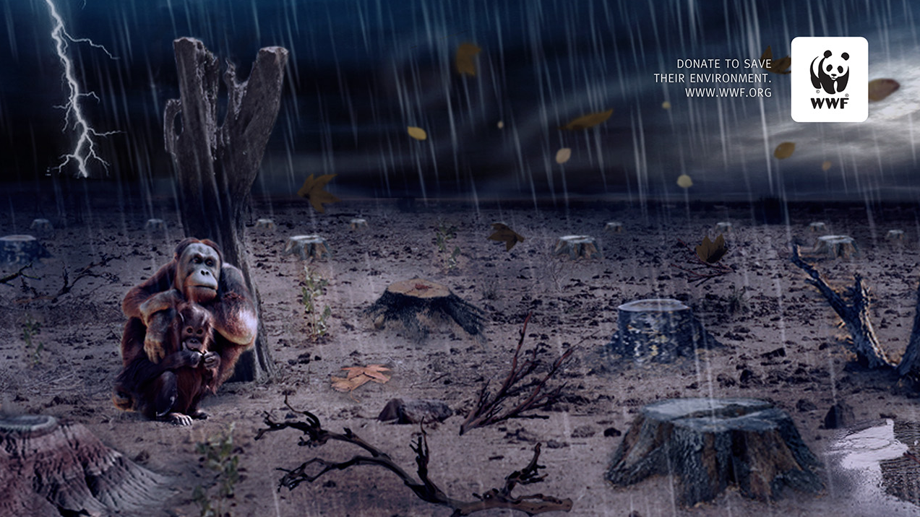
Setting the Scene: Exercise

Slide 8
That’s the end of Session One, thank you for taking part.

Slide 9
Welcome to Session Two

Slide 10
How to describe your character
Say what age they are
Use colour to describe them for example, what colour hair/eyes/clothes
What stands out for example, do they were glasses or have freckles

Slide 11
Story Plots
The plot is basically what is going to happen in your story. Over thousands of years, authors have used basic plot structures to help them think of the start, the middle and the end of their story and in all sorts of different genres. Some stories contain lots of plots, some only one.

Slide 12
Plot Types
Overcoming the Monster: This is most common of all plot types. In the story there is a baddie (the antagonist) who is threatening to do something against our main character (or the world). The monster could be a person, a government or a company or, indeed, a monster.
Quest: To overcome the monster, sometimes the main character has to go out on an adventure facing obstacles on the way.
Tragedy: Sometimes you cannot overcome the monster and there is no happy ending.
Rebirth: This is where the main character starts off as a sort of anti-hero, not so nice and kind but, through a series of events, realises the error of their ways and changes before it is too late.

Slide 13
Dilemmas’ and how we can sort them
Overcome a local issue about climate change or help overcome an issue by speaking to people in charge?
Go on a quest facing problems like people saying no to you (but in the end succeed)?
Find it really difficult to do anything, despite all your best efforts, because there is not enough support (and therefore your story is a tragedy)?
Manage to persuade someone who previously did not want to help fight the climate change problem to now do so?

Slide 14
Examples from other Climate Champions
The main character sees the devastation of the rainforest and starts a protest and wins the support of her MP.
Oil is polluting the sea causing fish to die as well as affecting coral. The main character starts a vlog which shows the extent of this to others, and he eventually speak to the United Nations.
The main character is sad that a local tree has been cut down and, with friends, organises a tree planting campaign in their local area. They also get the support of their Head Teacher.

Slide 15
And lastly, examples of Morals
It’s not too late to do something
Don’t let anybody stop you because no matter how old you are you can still make a big difference
Young or old we can make a change
Little changes can make a big difference

Slide 16
That’s the end of Session Two, thank you for taking part.

